Slide 1
Impervious Surface Area Estimation in HCMC, 2000
Presenter: Li Xi

Slide 2
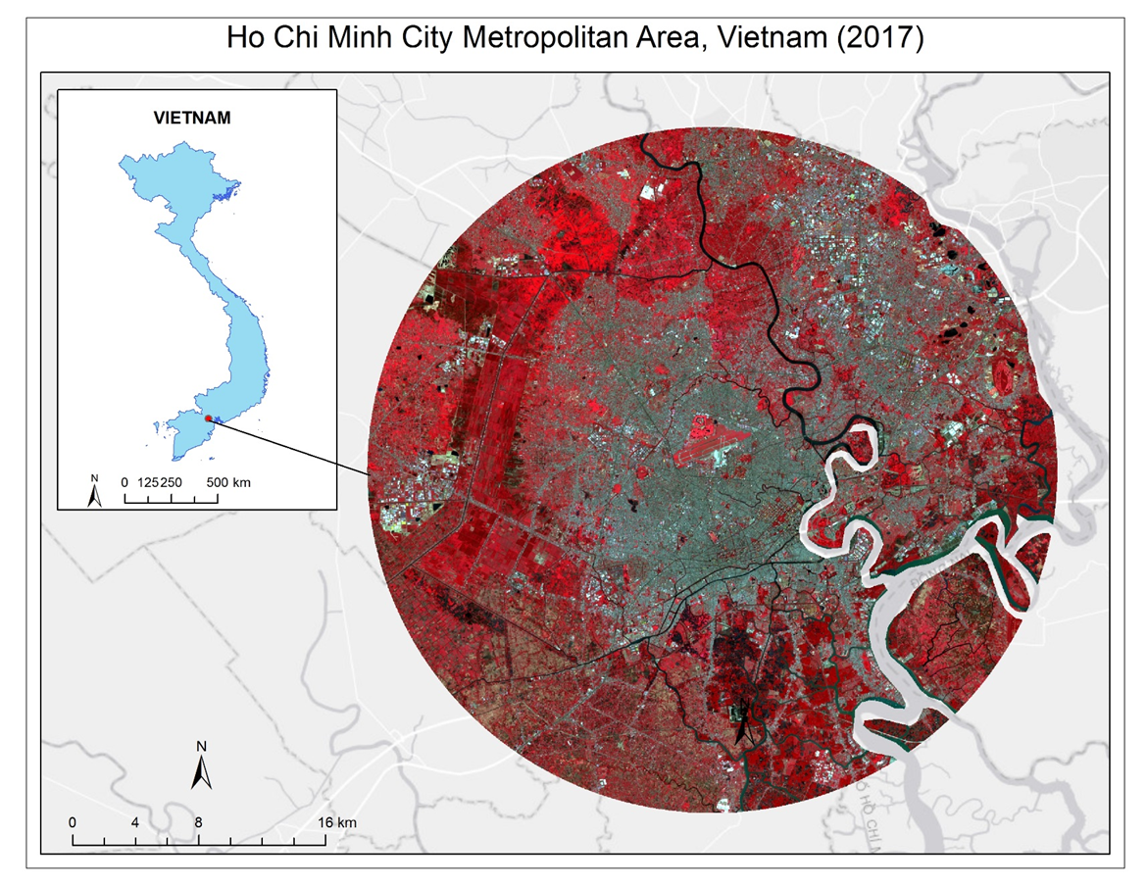
Study Area
Ho Chi Minh City, Vietnam
5.45 million (2001 population)
Expected to reach 11.6 million in 10 years

Slide 3


Data
Landsat surface reflectance images: 20000927
Google Earth Pro

Slide 4
Random Forests Regression
Randomly select training samples
Grow many regression trees without overfitting
Each tree has one vote
The forest chooses the best prediction based on the votes

Slide 5
Step 1:

Slide 6
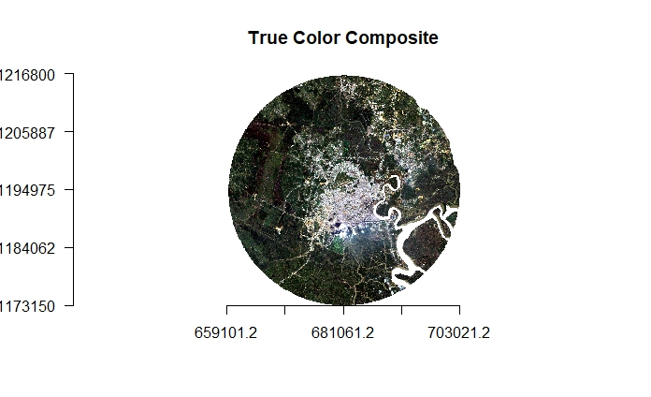
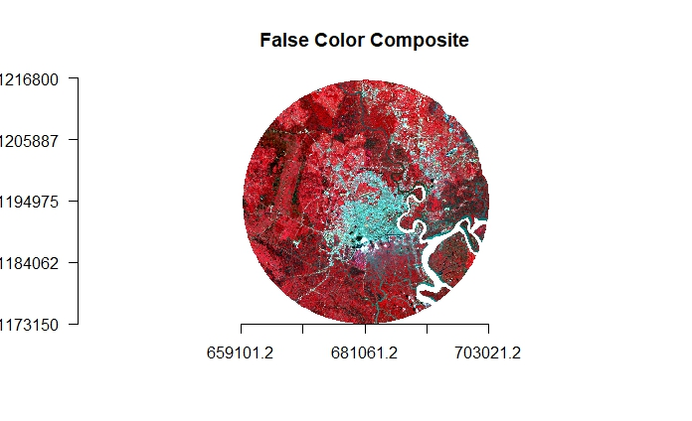
Notes:
Input data

Slide 7
Step 2:

Slide 8
Step 3:

Slide 9
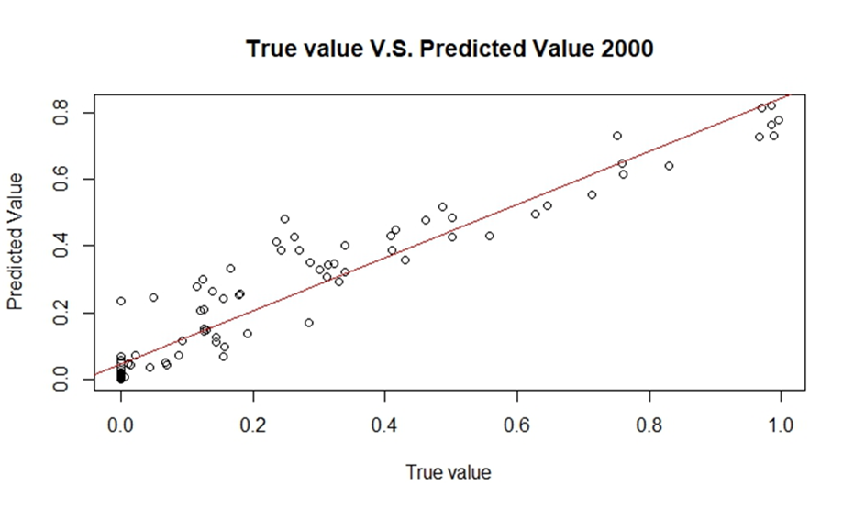
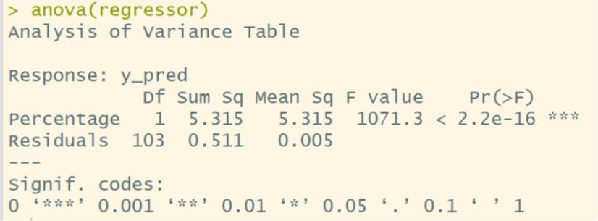

Slide 10
Accuracy assessment

Slide 11
Conclusion
There is a clear linear correlation between the true urban percentage values and the predicted values.
Urban area results estimated from Landsat seems satisfactory with a mean absolute errors of 5.9%, and a systematic errors of 0.29%.
More researches are recommended in studying the impacts of increasing impervious cover in local climate, air and water quality, and agricultural production.

